Slide 1
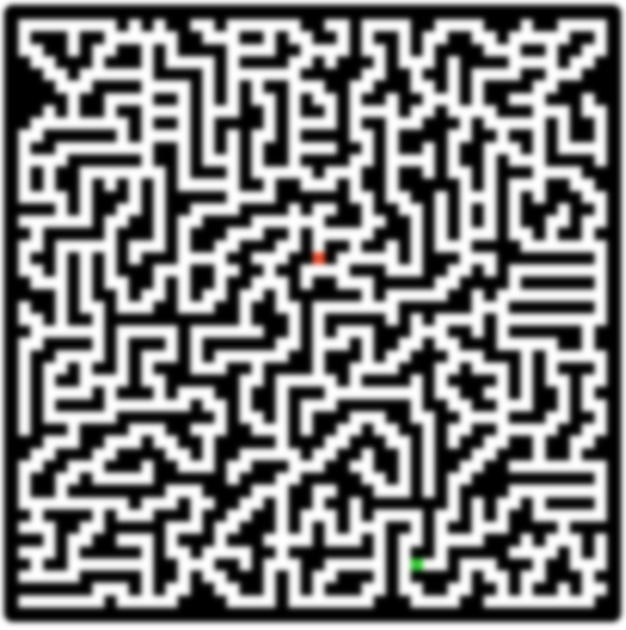
How is the maze generated?

Slide 2
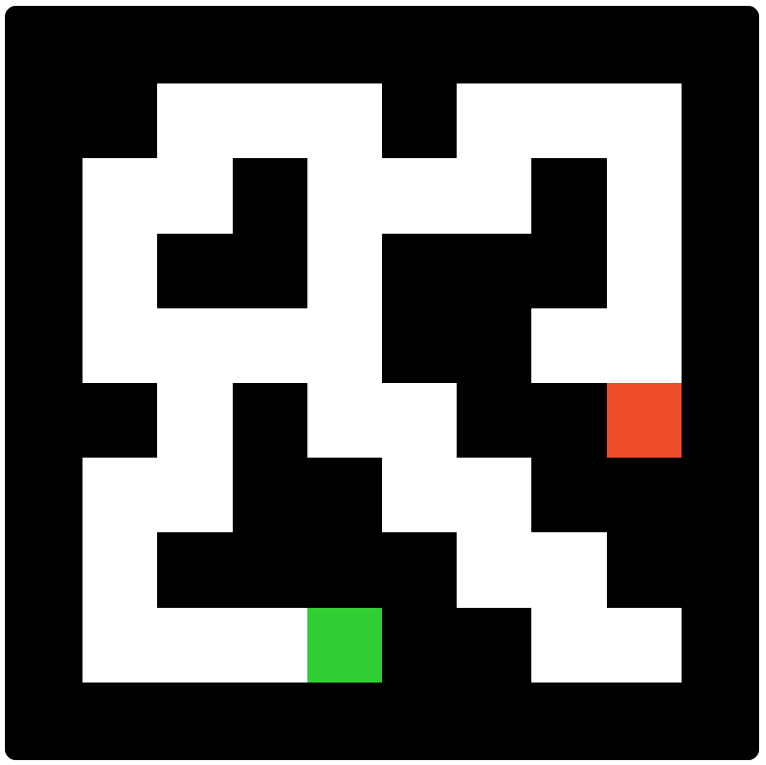
Create random paths
The maze generates by creating paths, and MANY of them
The path continues to random directions where it can, and when the path can’t continue anymore, or the path’s max length is reached, the path ends.
A new path starts from a random position from any path in the maze, so they all will be connected to each other. Sometimes the new path’s position can’t continue to any direction, and then the path just stops, before anything is created.
And that’s how it works, it just loops new paths to the maze. And at the end, it chooses the START and GOAL positions, from path endings

Slide 3

Where can path continue?
Path’s latest position
The directions which to detect
When path is generating itself, it always checks the directions where it can continue, and it chooses one of them randomly.
So, when a path is checking for directions, it checks all 4 of them, and each direction detects 5 cells like a U shape. If any of the detected cells isn’t a wall, then that direction isn’t possible.
Why checking cells like a U shape?
It gets you clear mazes, because then the paths’ corners can’t be next to each other. It also gives the chance to have multiple paths to the finish.
The detected cells in that direction

Slide 4
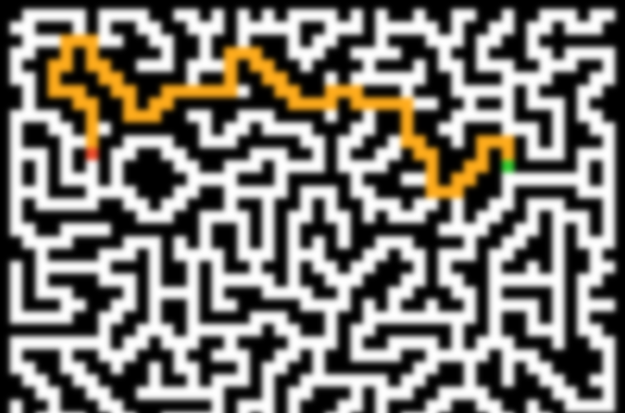
How does the Search work?

Slide 5
Breadth First Search Explained
1
Breadth First Search is a clever algorithm to find the fastest path from start to finish.
It works by searching towards every possible direction cell by cell. And when a searched cell finds the goal for the first time, the path that led to it, will always be the fastest path.
For more information, you can google this algorithm
2
3
4
5
6
7
8

Slide 6

My Implementation
In my implementation, I loop “frames” until the path is found.
Every frame, it loops through all search paths, and a path does one of the following
Only 1 possible direction: search that direction and add it to its path
More than 1 possible direction: search one direction and add it to its path, AND create copies of the path for the other directions (and search the directions to those paths as well)
No possible direction: that path can’t move anymore, and it hasn’t reached the goal, so delete this path.
If any path has reached the goal, then that path is selected as the winningPath.
1
1
1
2
2
and 2
2 possible directions to continue (numbers represent the path ID)
Original path continues up
Copies the path, searches the other direction, and that path is added to the paths list.

